Slide 2

NgRx

Slide 3
Agenda
What is NgRx? Check List Dispatching an Action
Use NgRx when? Check List Subscribing to the Store
Do not use NgRx when?
Redux Pattern
Redux Principle
Advantages of Redux Pattern
Check List for Store
Check List Reducer

Slide 4
Angular – NgRx
What is NgRx?
NgRx stands for Angular Reactive Extensions. NgRx is a state management system that is based on the Redux pattern.
NgRx is one of the libraries used for application state management. It is a Redux implementation for Angular.
NgRx is for optimally storing data in the client and recalling them from all over the application, usually.

Slide 5
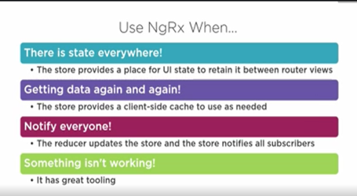
Angular – Use NgRx when

Slide 6
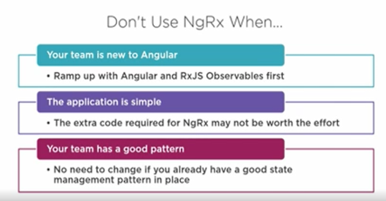
Angular – Do not use NgRx when

Slide 7
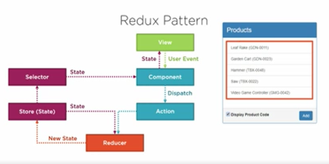
Angular – Redux Pattern

Slide 8
Angular – Redux Pattern
with NgRx, each time user selects the product, the component dispatch an action.
Reducer uses that action and the current application state from the store to define new state and update the store with this new state.
Store then retain the current product. Any component can subscribe to the current product selector to receive change notifications and the associated views display the information appropriate for the current product.
It is cleanly de-coupled, the component do not put data directly into the store rather they dispatch the action to reducer to update the store.
Components do not read data directly from the store rather they subscribe to the store through selectors to receive state change notification. And since all of the components getting the state from the single source of truth, the state is consistently rendered.

Slide 9
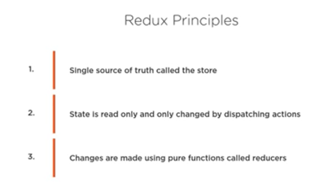
Angular – Redux Principle

Slide 10
Angular – Redux Principle
with NgRx, store provides client-side cache.
using this pattern state is immutable which means it is never modified instead reducer creates new state from the existing state and define the actions. Making state changes much more explicit.
store is literally a JavaScript object that holds all your application state. You can think it like client-side database.
reducer are the pure function

Slide 11
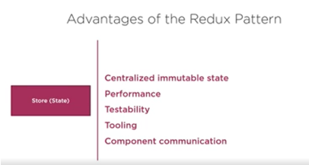
Angular – Advantages of Redux Pattern

Slide 12
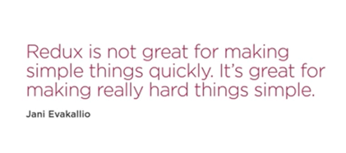
Angular – Redux

Slide 13
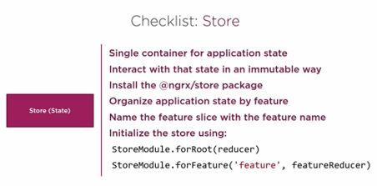
Angular – Check list Store

Slide 14
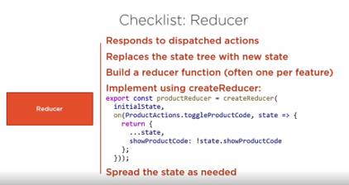
Angular – Check list Reducer

Slide 15
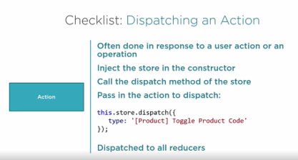
Angular – Check list Dispatching an Action

Slide 16
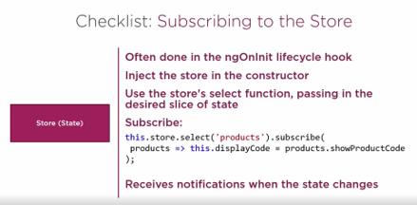
Angular – Check list Subscribing to the Store

Slide 17
THANK YOU

